Slide 1
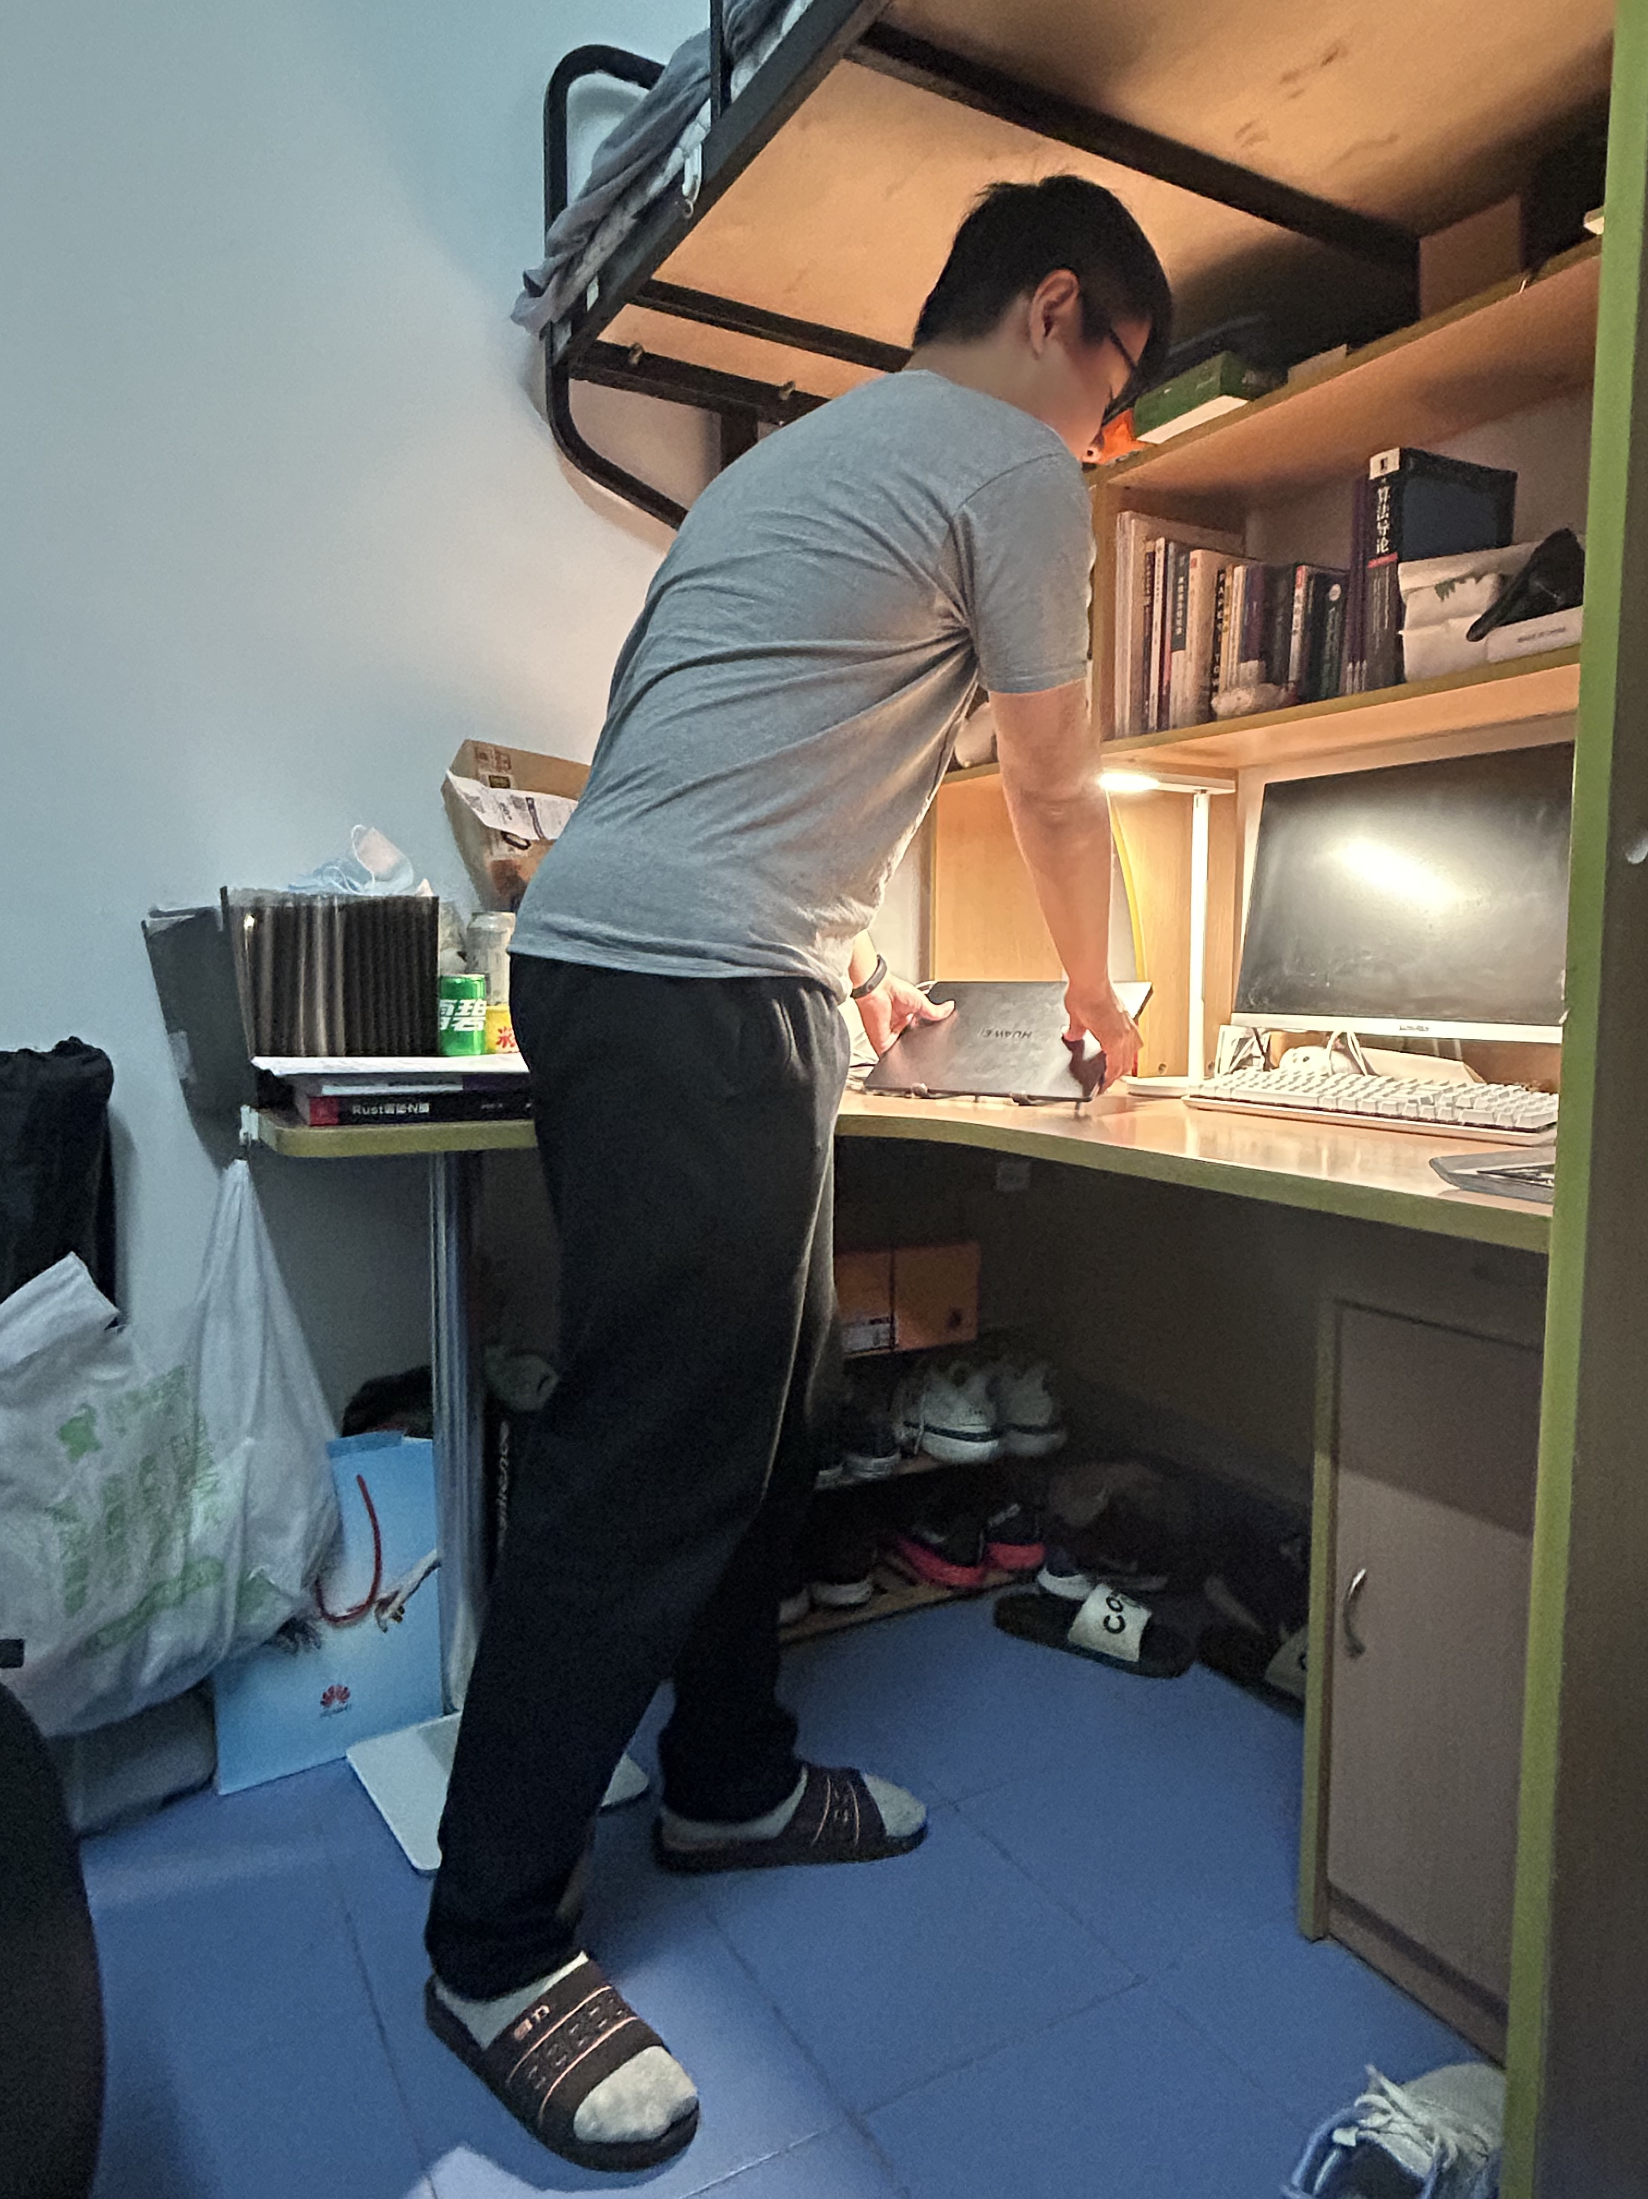
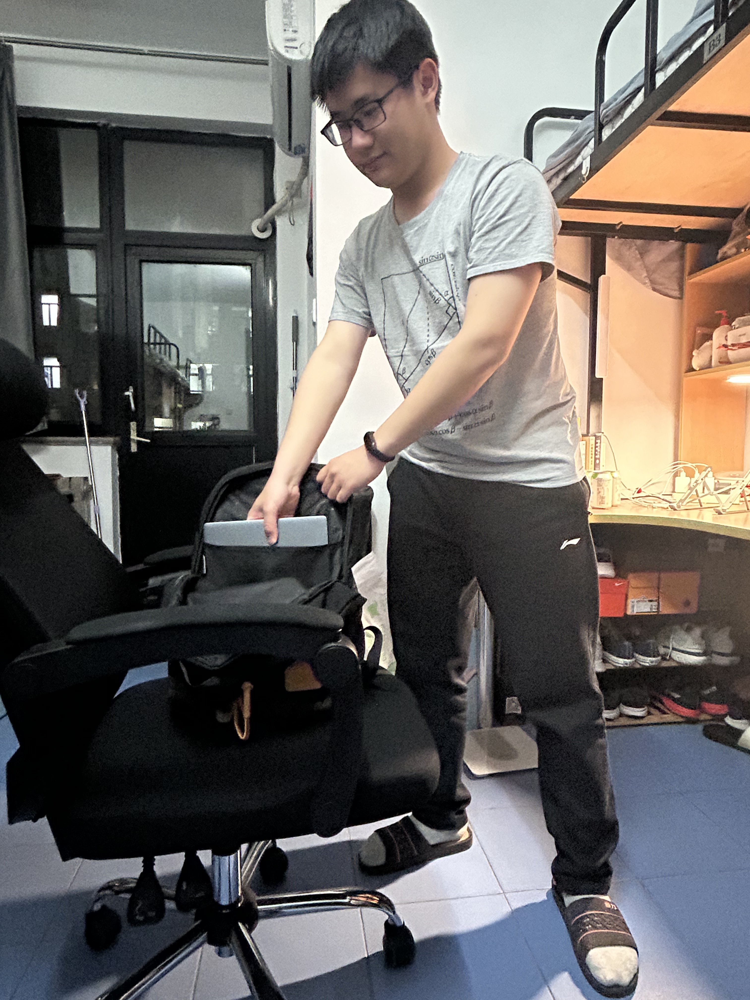
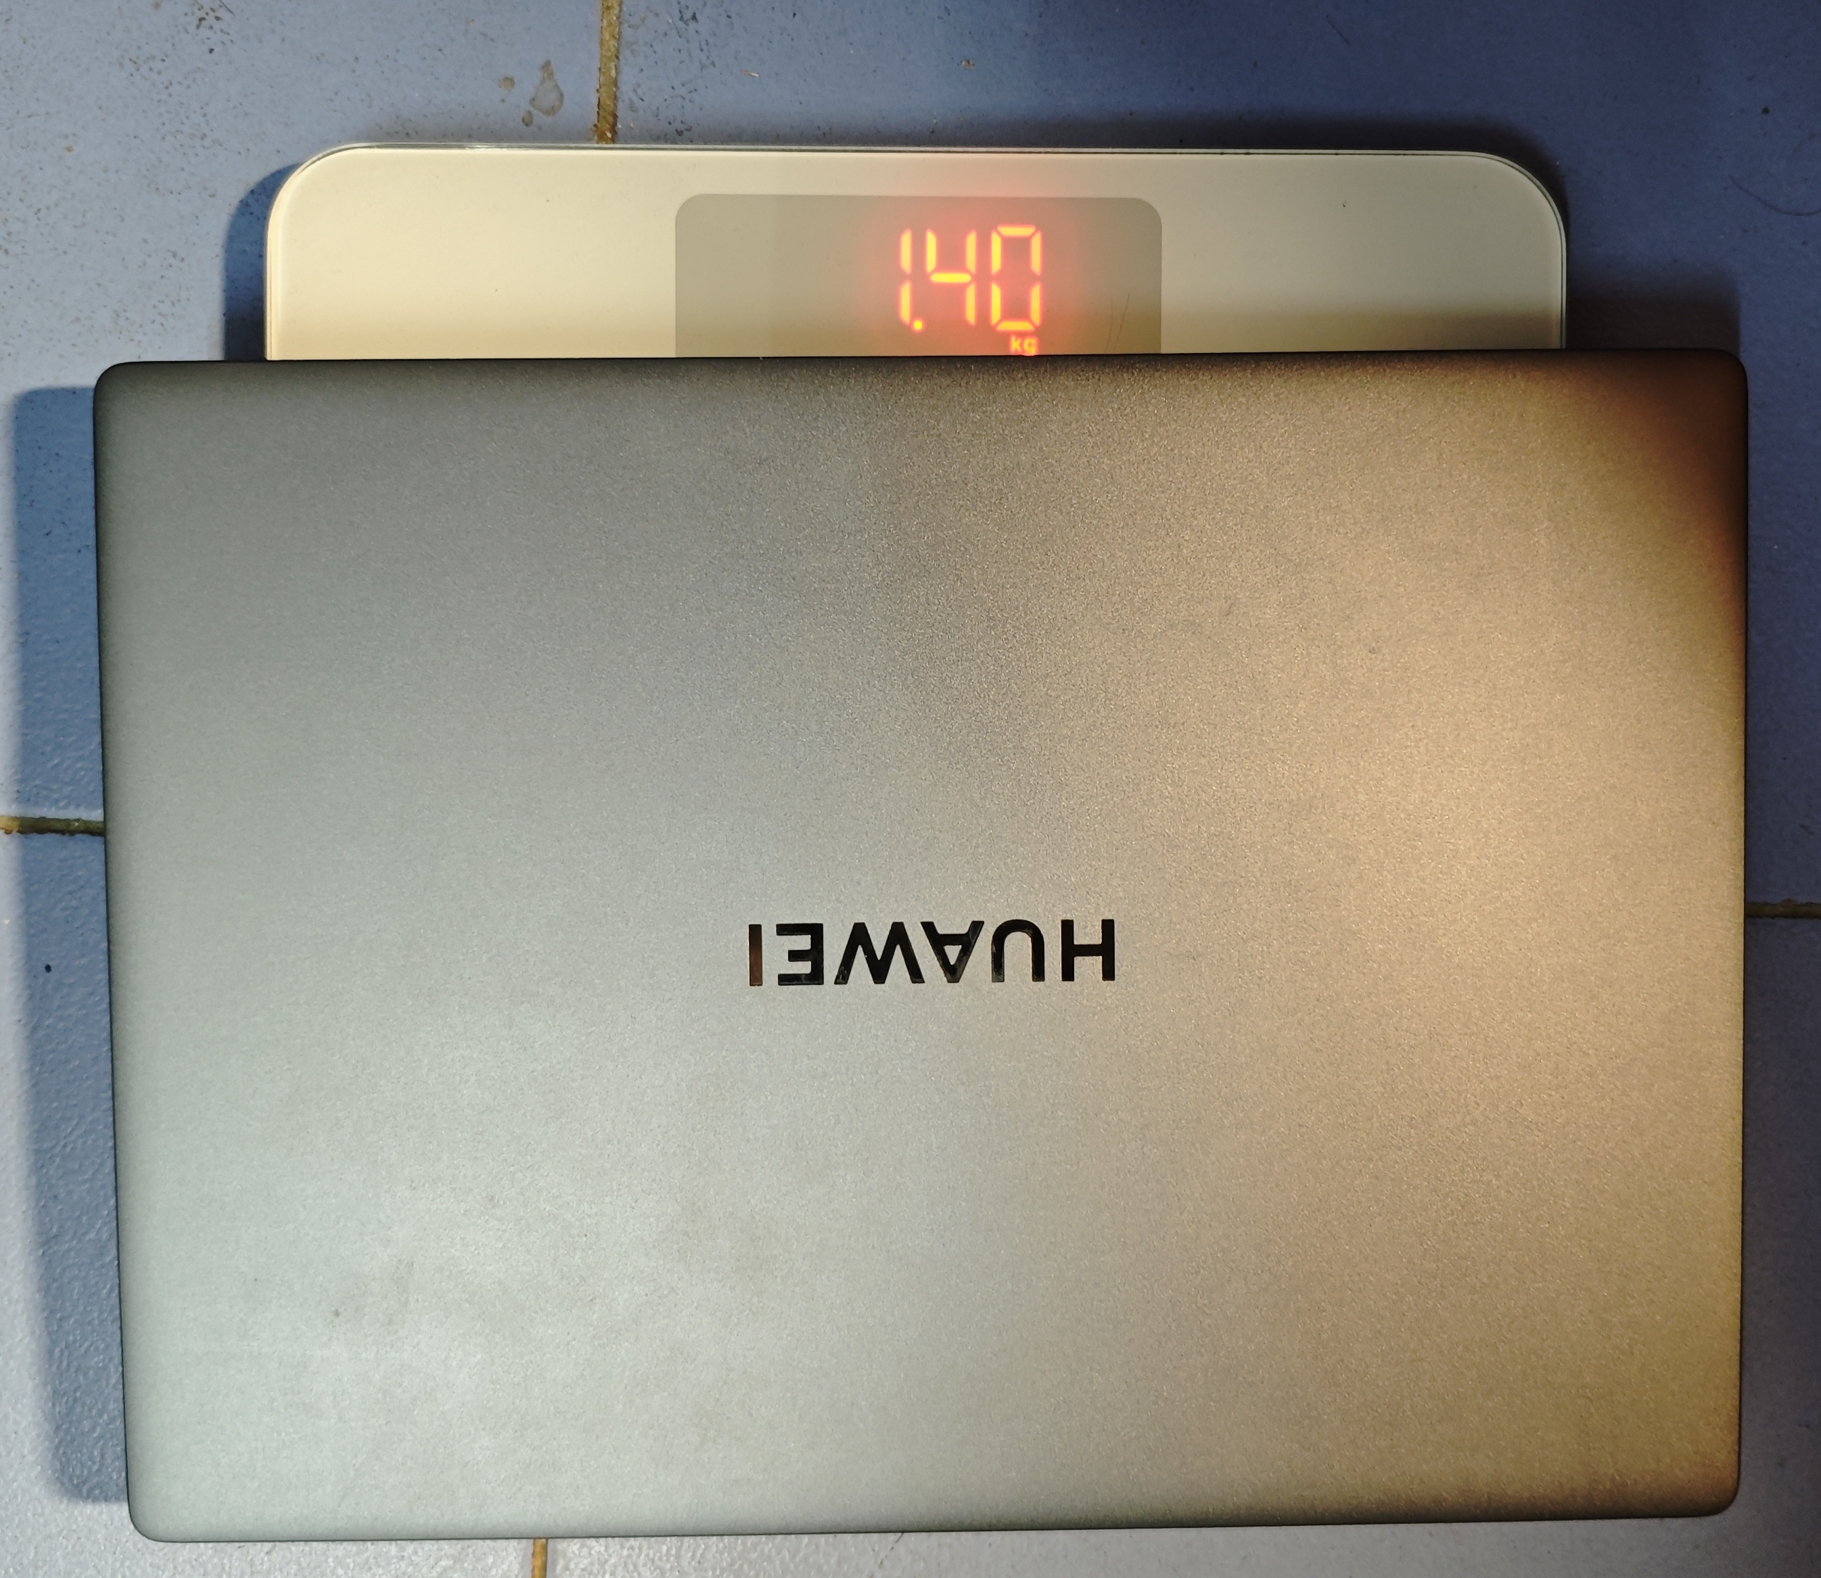
75.81cm
68.34cm
47°
47°

Slide 2
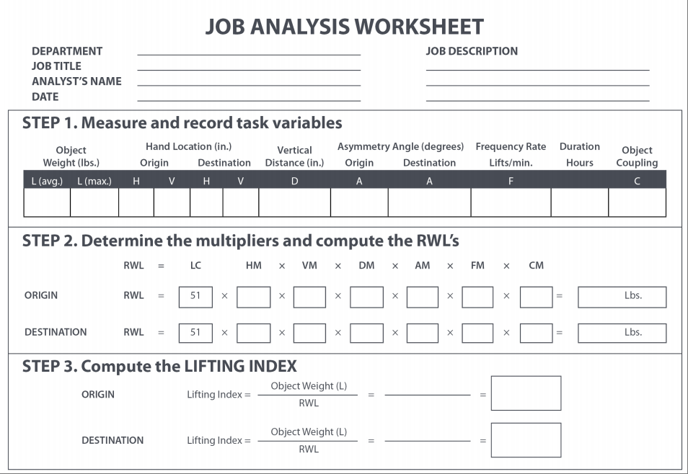
3.086 3.086 6.18 29.85 6.33 26.90 2.95 47° 47° <0.2 <1 poor
1.00 0.96 1.00 0.86 1.00 0.90 37.89
1.00 0.96 1.00 0.86 1.00 0.90 37.89
3.086
0.081
37.89
3.086
0.081
37.89

